Slide 1

POMS 6220 Class Project
Saumya Joshi
Nishka Srikanth,
Pavani Narla,
Ela Williams

Slide 2

Unlocking Insights into Student Performance with Machine Learning
Understanding the impact of parental education, lunch quality, and location on academic outcomes

Slide 3

Problem Statement
Education is critical, but student performance is influenced by multiple factors that are often overlooked.
Educators and policymakers lack data-driven insights into:
How parental education impacts student success.
The role of lunch quality and preparation in academic outcomes.
The role of location in the academic outcomes.
Predicting student performance effectively for targeted interventions.
Why It Matters:
Understanding these factors can help:
Improve teaching strategies.
Allocate resources more effectively.
Support students in achieving their full potential.

Slide 4

Storyline
Parents with higher education levels often show their children an appreciation for learning. These parents may create extraordinary home environments, encourage reading, and provide extensive academic support. Early exposure to intellectual pursuits can significantly impact a child's academic performance, leading to higher test scores and grades. Moreover, families with higher educational backgrounds tend to have higher incomes, allowing them to afford quality education, including private schools or homes in the best school districts. These schools often have superior resources, smaller class sizes, and experienced teachers, further enhancing a child's learning experience. However, it is important to note that their family's socioeconomic status does not solely determine a child's success. Many students from disadvantaged backgrounds excel due to their curiosity, perseverance, and strong personal drive to succeed. A supportive family environment and a child's motivation can create a potent recipe for academic achievement.

Slide 5
Factors affecting student's academic performance
Parental Education
Lunch
Type
Location
(residence)

Slide 6
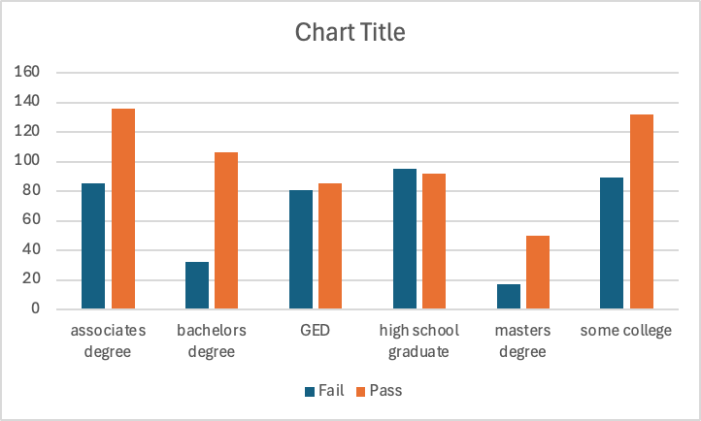
Current Understanding
Parental Education Vs Pass/Fail
Are students whose parents have higher education scoring better on average?

Slide 7
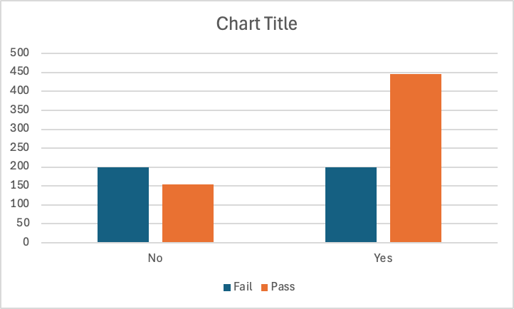
Current Understanding
Lunch Type Vs Pass/Fail
Is there a performance gap based on lunch type, possibly indicating socio-economic influences?

Slide 8
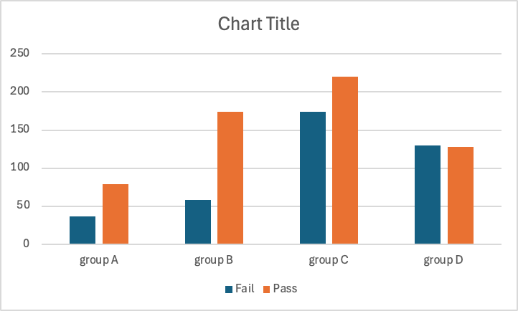
Current Understanding
Group A – Highest cost per student
Group D – Lowest cost per student
Location/ School Ranking
vs Pass/Fail
Does geographical location influence academic performance?

Slide 9






CRISP DM Model
Education Understanding
Source Data from Kaggle
Data Preparation
Training/Testing Modeling in Weka
Deployment
Evaluation/ Adjustments
Finalize

Slide 10

Methodology
Source and Initial State of Data:
The dataset is sourced from Kaggle and was already pre-cleaned to a significant extent.
Initial inspection revealed redundant and irrelevant columns, which needed modification for better usability and analysis.
Modifications and Feature Engineering:
Ethnicity to Location Transformation:
The 'ethnicity' column was replaced with 'location' to align better with the correlation to degrees and contextual analysis.
The transformation maintained the dataset's interpretability and statistical relevance.
Removal of Redundancy:
The 'total score' column was removed since individual test scores already provided sufficient granularity.
This ensured no duplication of information and streamlined data for modeling.

Slide 11

Pass/Fail Column Creation: A new column, 'Pass/Fail', was derived based on the scoring system:
Scores of 67 and below were categorized as "Fail."
Scores of 68 and above were categorized as "Pass."
This binary classification helped in subsequent categorical analysis.
Education Level Standardization:​ Adjustments were made to ensure uniformity:
'Some high school' was standardized to 'GED.'​
'High school' was renamed to 'High School Graduate.'​
Other categories like 'Masters,' 'Bachelors,' 'Associates,' and 'Some College' were left unchanged.
Score Filtering: Data was sorted by scores from lowest to highest to evaluate distributions and identify outliers.
Scores were cross-checked against education levels to ensure logical consistency.
Preparation for WEKA:
The cleaned dataset was saved in an appropriate format compatible with WEKA.
All categorical variables were encoded, and numerical values were normalized as needed for specific algorithms.
The dataset was checked for missing values, ensuring completeness before running machine learning models.

Slide 12

Data Models
For the analysis, we employed three distinct machine learning models:
Random Tree
Naive Bayes Classifier
Multi-Class Classifier
Each model was chosen to address specific objectives within the dataset, leveraging their unique capabilities for classification and evaluation.
Cluster

Slide 13
Introduction to Models Used Random Tree:
This model was selected for its ability to handle non-linear data relationships effectively. Random Tree is robust in managing large datasets with numerous features, making it ideal for exploring complex interactions within our dataset.
The model provides interpretable outcomes through a confusion matrix and detailed performance metrics such as accuracy, precision, recall, and F1-score. These metrics help identify the classification performance in distinguishing between "Pass" and "Fail" categories.
Its high accuracy and low error rates demonstrated suitability for datasets requiring precise predictions.

Slide 14
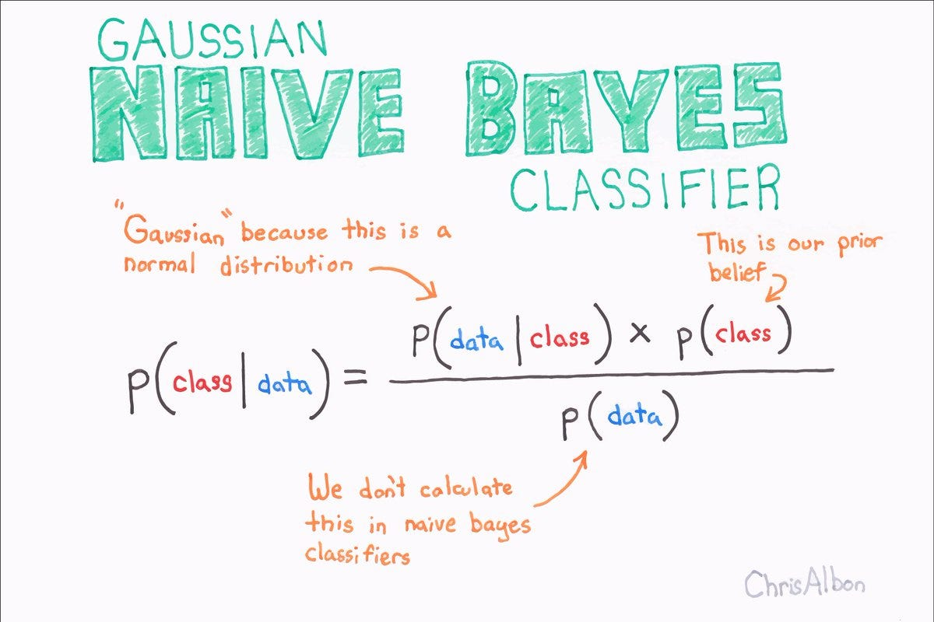
Naive Bayes Classifier
This probabilistic model was chosen for its simplicity and efficiency in handling categorical and numerical data. Naive Bayes assumes feature independence, making it computationally efficient for large datasets.
Its primary advantage lies in quick execution and reliable performance for datasets where independence assumptions hold reasonably well.
This model enabled us to assess and validate the dataset from a probabilistic standpoint, providing complementary insights alongside more complex models.

Slide 15
Multi-Class Classifier
Selected for its capability to handle multiple classes simultaneously, the Multi-Class Classifier was essential for evaluating nuanced patterns in the data.
It leverages logistic regression with a focus on identifying and distinguishing fine-grained classes within the dataset, delivering granular insights.
This model ensured that detailed relationships and varying class distributions were adequately captured, particularly for multi-dimensional attributes.

Slide 16

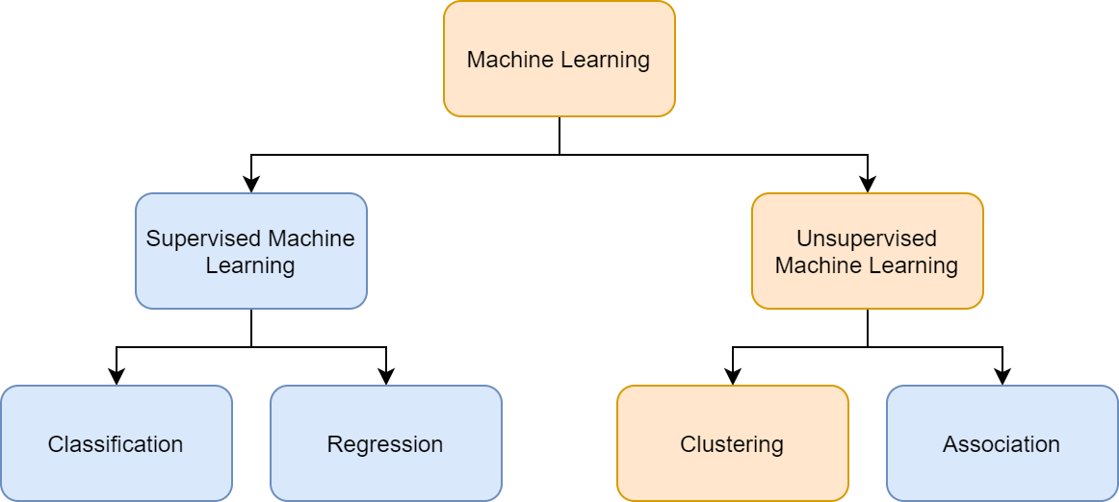
Clustering Techniques
Clustering was employed to uncover inherent patterns and relationships within the data without predefined labels.
This technique is instrumental in understanding data distributions, identifying group similarities, and pinpointing outliers or anomalies.
The insights gained from clustering further enhanced the interpretability of classification results and provided a holistic understanding of the dataset.

Slide 17
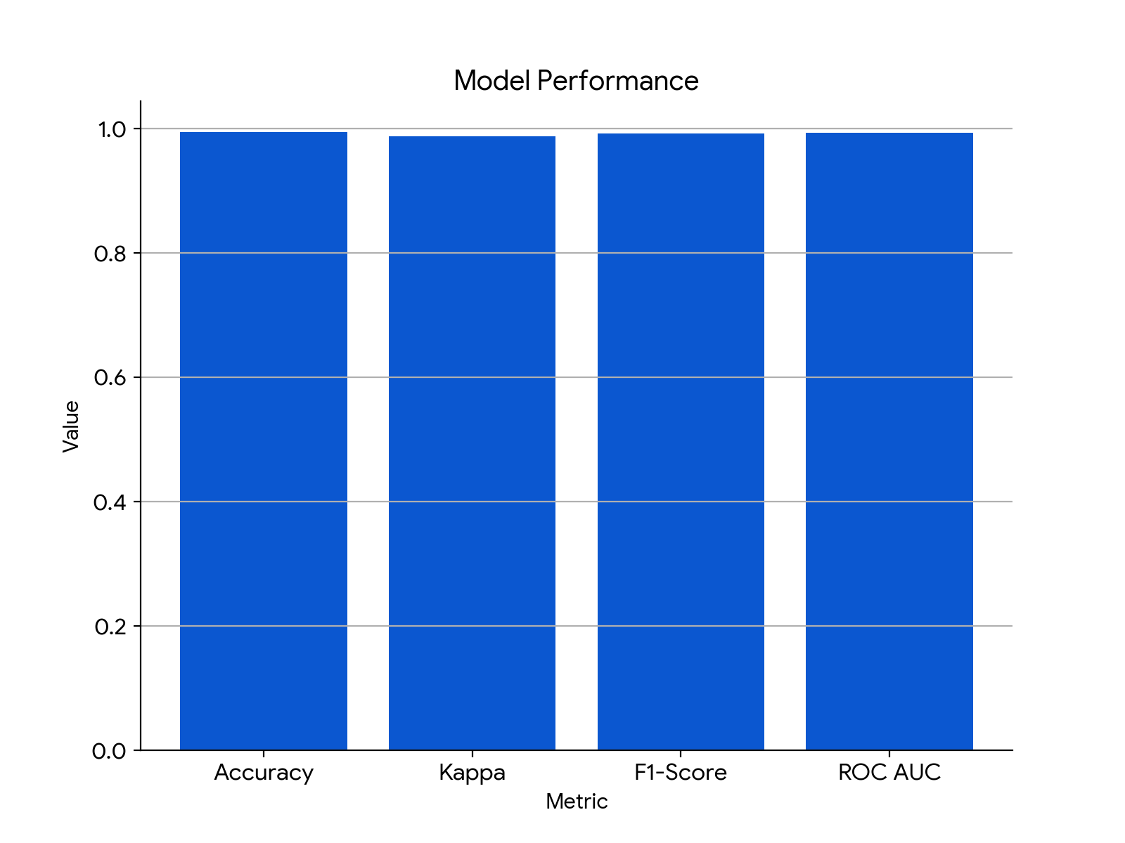
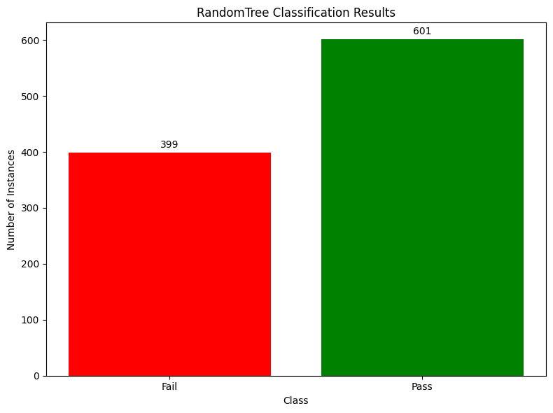
Model 1 - Random Tree
=== Detailed Accuracy By Class ===
TP Rate FP Rate Precision Recall F-Measure MCC ROC Area PRC Area Class
0.990 0.003 0.995 0.990 0.992 0.987 0.993 0.989 Fail
0.997 0.010 0.993 0.997 0.995 0.987 0.993 0.992 Pass
Weighted Avg.
0.994 0.007 0.994 0.994 0.994 0.987 0.993 0.991
=== Confusion Matrix ===
a b <-- classified as
395 4. | a = Fail
2 599 | b = Pass
RandomTree
==========
=== Stratified cross-validation ===
=== Summary ===
Correctly Classified Instances 994 99.4 %
Incorrectly Classified Instances 6 0.6 %
Kappa statistic 0.9875
Mean absolute error 0.006
Root mean squared error 0.0775
Relative absolute error 1.2509 %
Root relative squared error 15.8179 %
Total Number of Instances 1000
Data Breakdown:
Model Performance:
Accuracy: 99.4%
Kappa statistic: 0.9875 (very strong agreement)
F1-score: 0.992 (excellent precision and recall)
ROC Area: 0.993 (excellent classification performance)
Confusion Matrix:
True Positives (TP): 395 (Correctly predicted as Fail)
True Negatives (TN): 599 (Correctly predicted as Pass)
False Positives (FP): 4 (Incorrectly predicted as Pass)
False Negatives (FN): 2 (Incorrectly predicted as Fail)

Slide 18
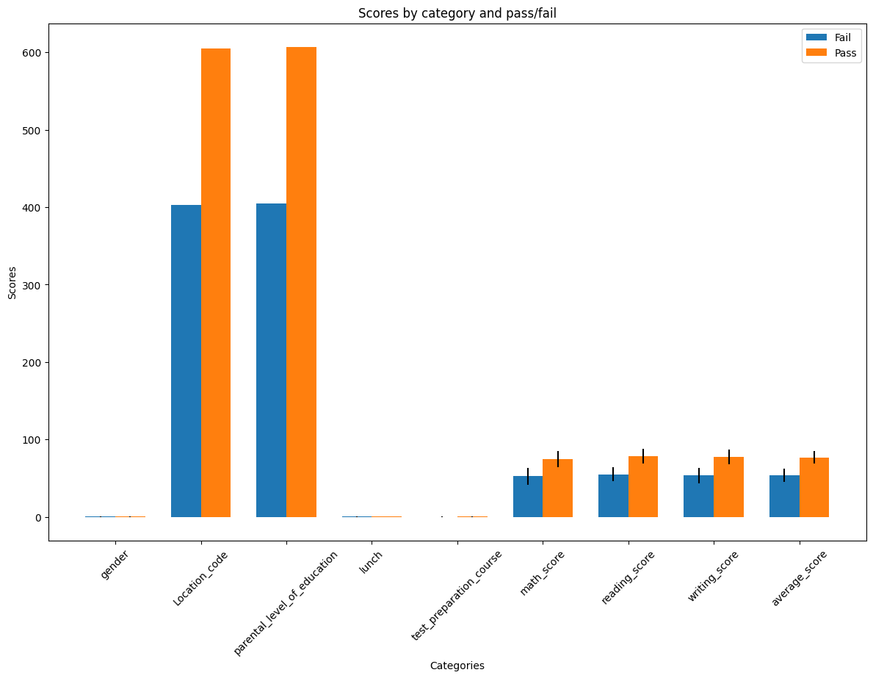
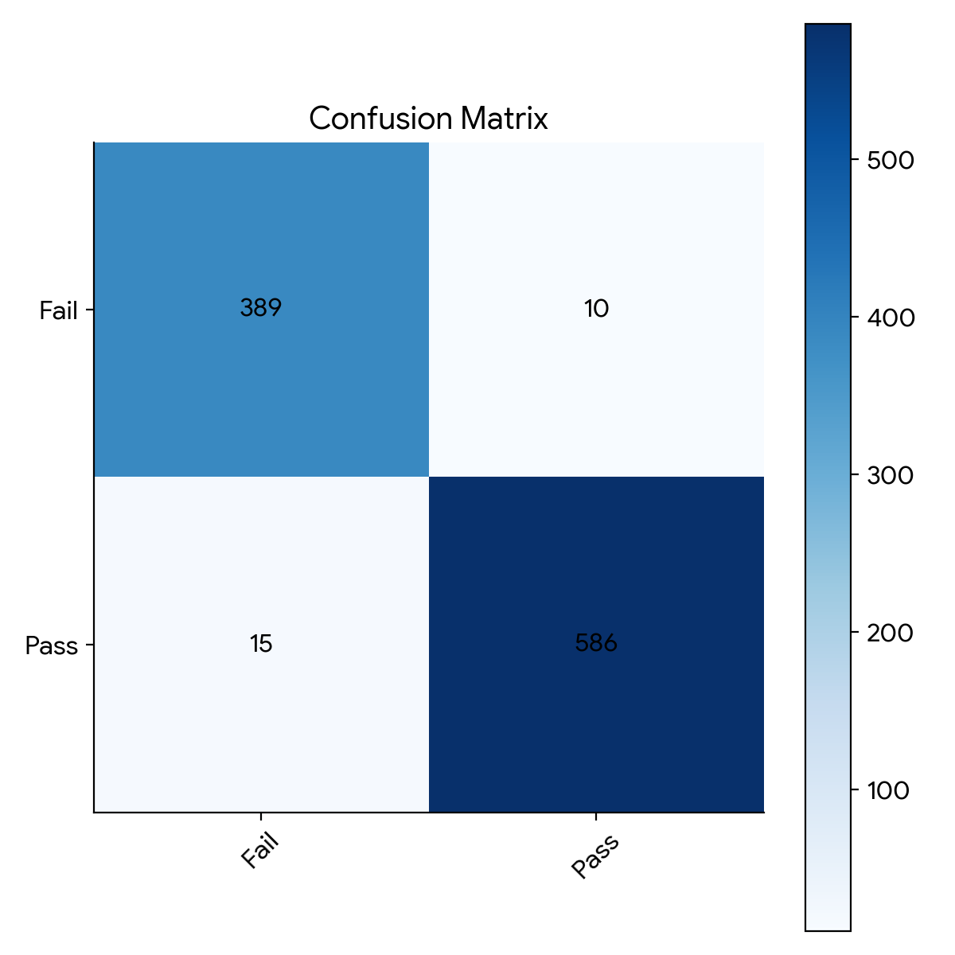
Model 2 - Naive Bayes Classifier
=== Stratified cross-validation ===
=== Summary ===
Correctly Classified Instances 975 97.5 %
Incorrectly Classified Instances 25 2.5 %
Kappa statistic 0.948
Mean absolute error 0.041
Root mean squared error 0.1263
Relative absolute error 8.5429 %
Root relative squared error 25.7912 %
Total Number of Instances 1000
=== Detailed Accuracy By Class ===
TP Rate FP Rate Precision Recall F-Measure MCC ROC Area PRC Area Class
0.975 0.025 0.963 0.975 0.969 0.948 0.999 0.998 Fail
0.975 0.025 0.983 0.975 0.979 0.948 0.999 0.999 Pass
Weighted Avg.
0.975 0.025 0.975 0.975 0.975 0.948 0.999 0.999
=== Confusion Matrix ===
a b <-- classified as
389 10 | a = Fail
15 586 | b = Pass

Slide 19

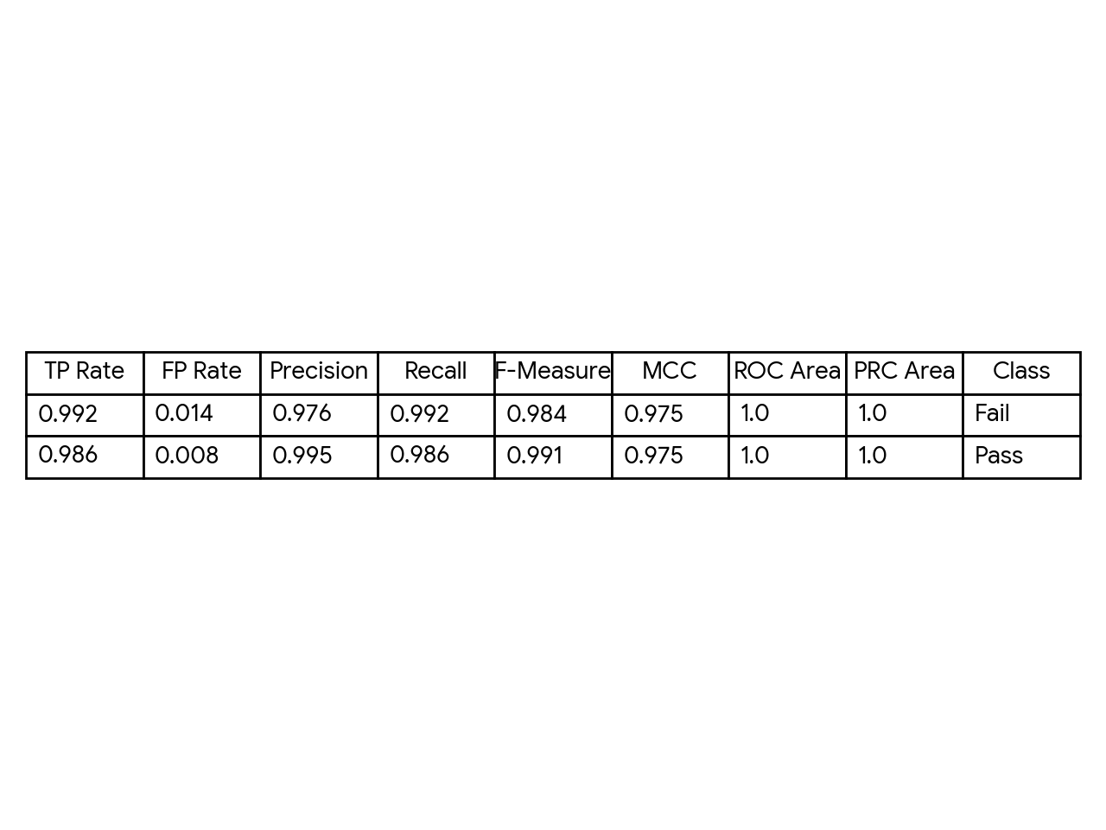
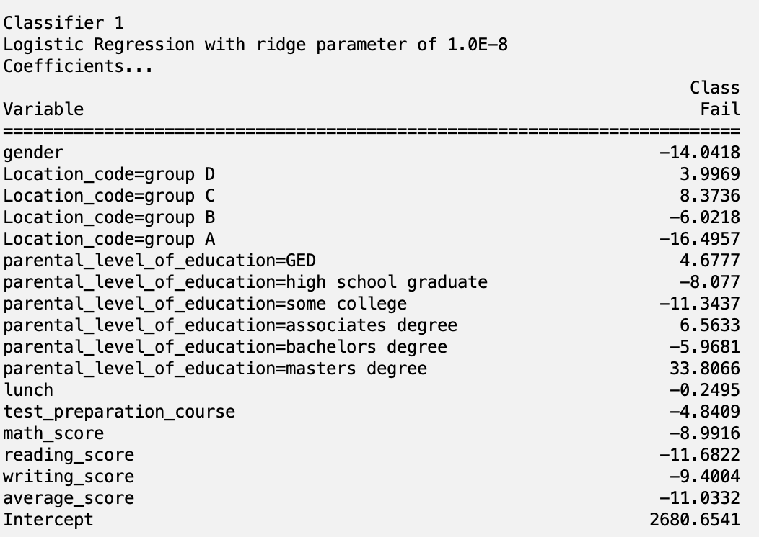
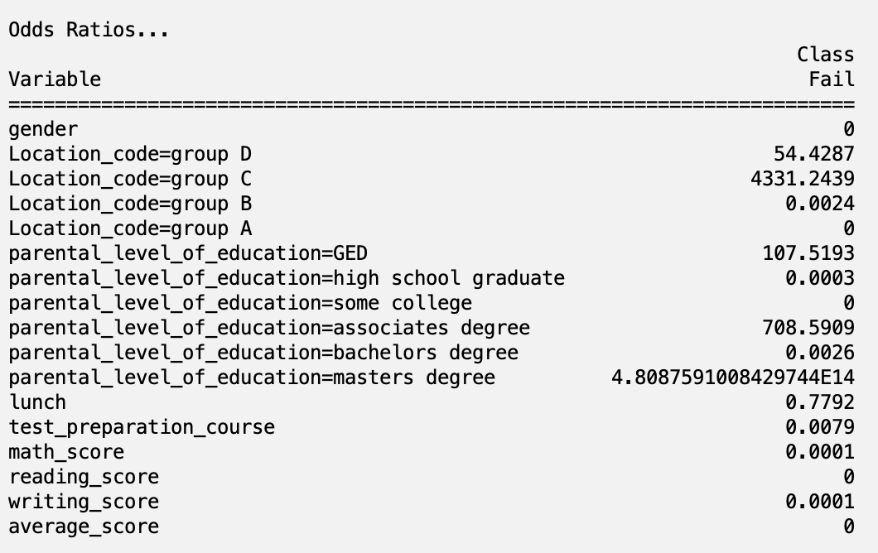
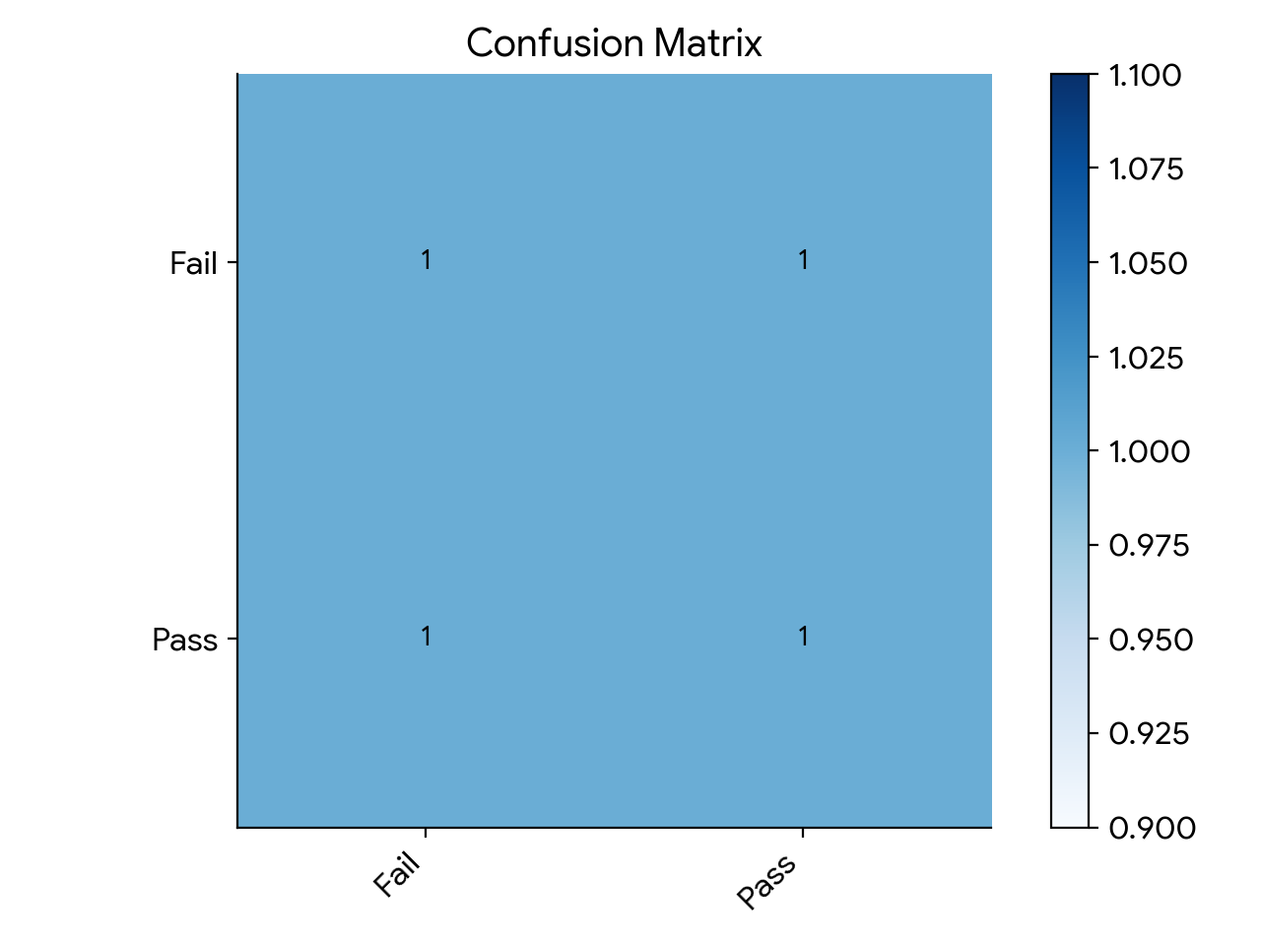
Model 3- MultiClassClassifier
=== Confusion Matrix ===
a b <-- classified as
124 1. | a = Fail
3 212 | b = Pass

Slide 20
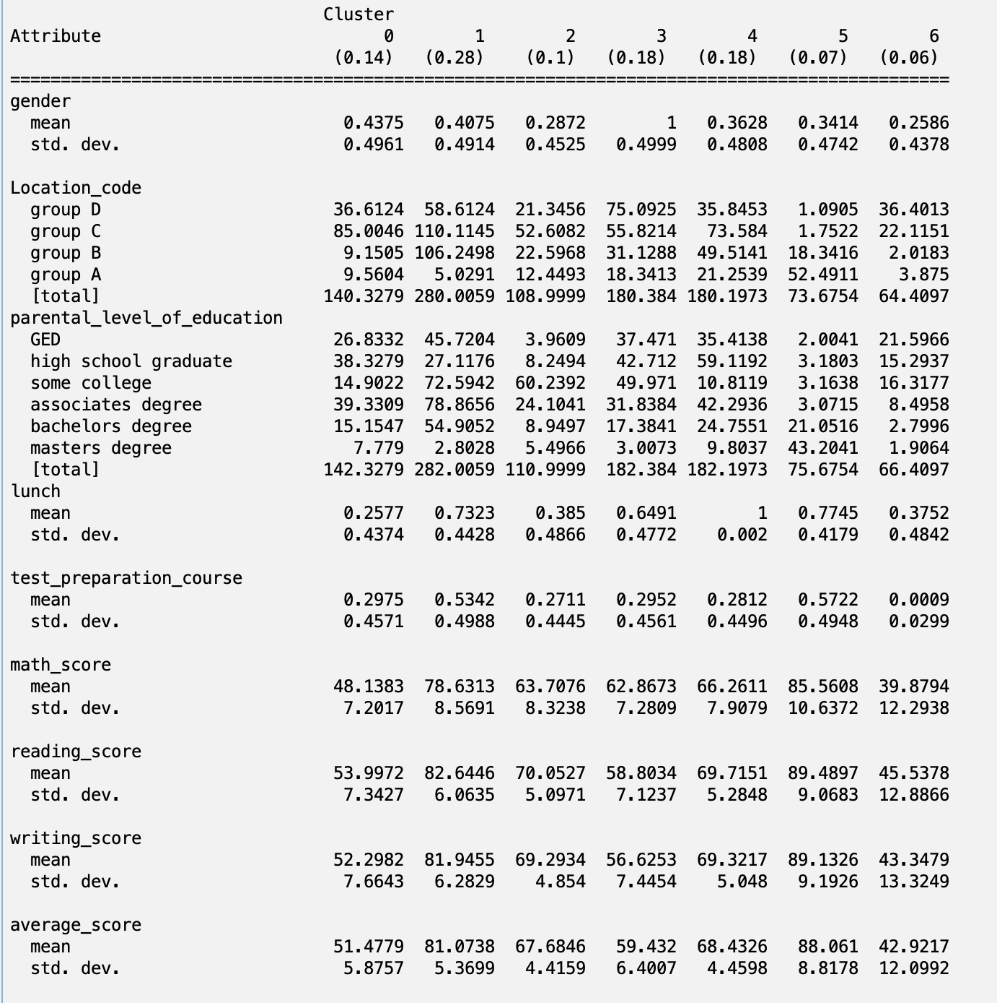
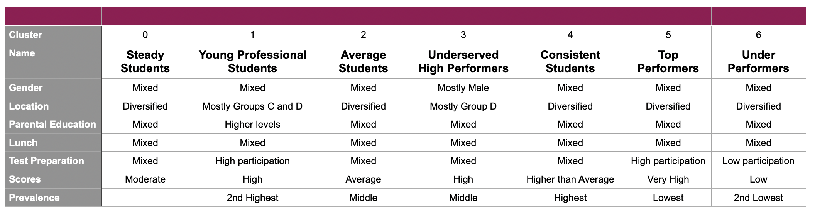
Model 4 - Clusters
Cluster List
0 – Steady Students
1 – Young Professional's Students
2 – Average Students
3 – Underserved High Performers
4 – Consistent Students
5 – Top Performers
6 – Under Performers
Variables explained
Gender (male or female), Location is school ranking denoted by group A (best) to group D (worst), Parental education is the highest grade a parent achieved, lunch is whether it is offered free at the school, test prep is based on participation, math, reading, writing, and average are the student's performance.

Slide 21
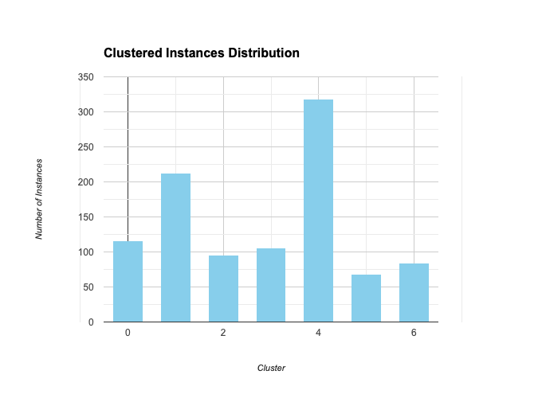
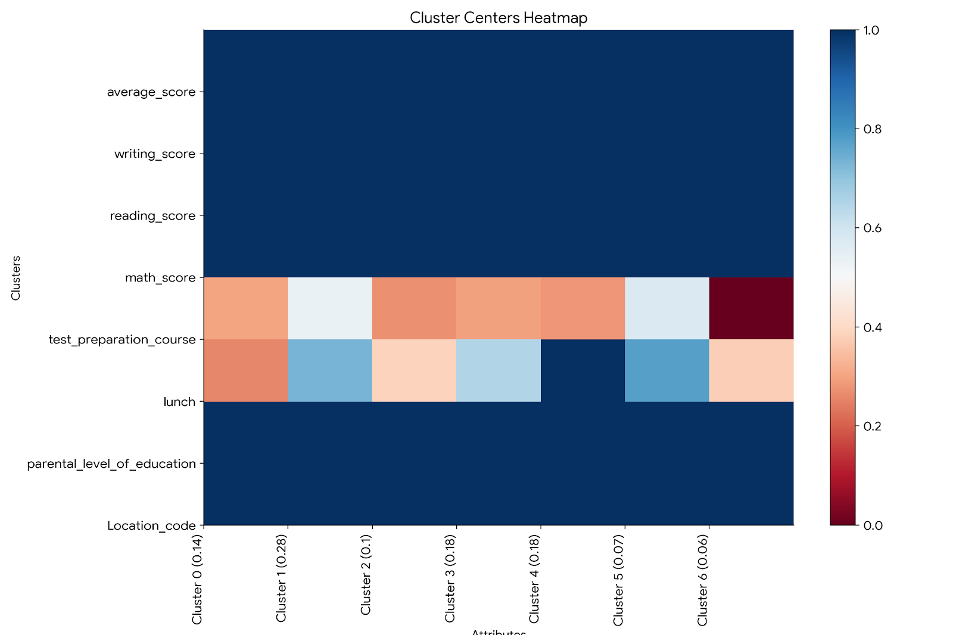
Cluster Heat Map & Distribution

Slide 22
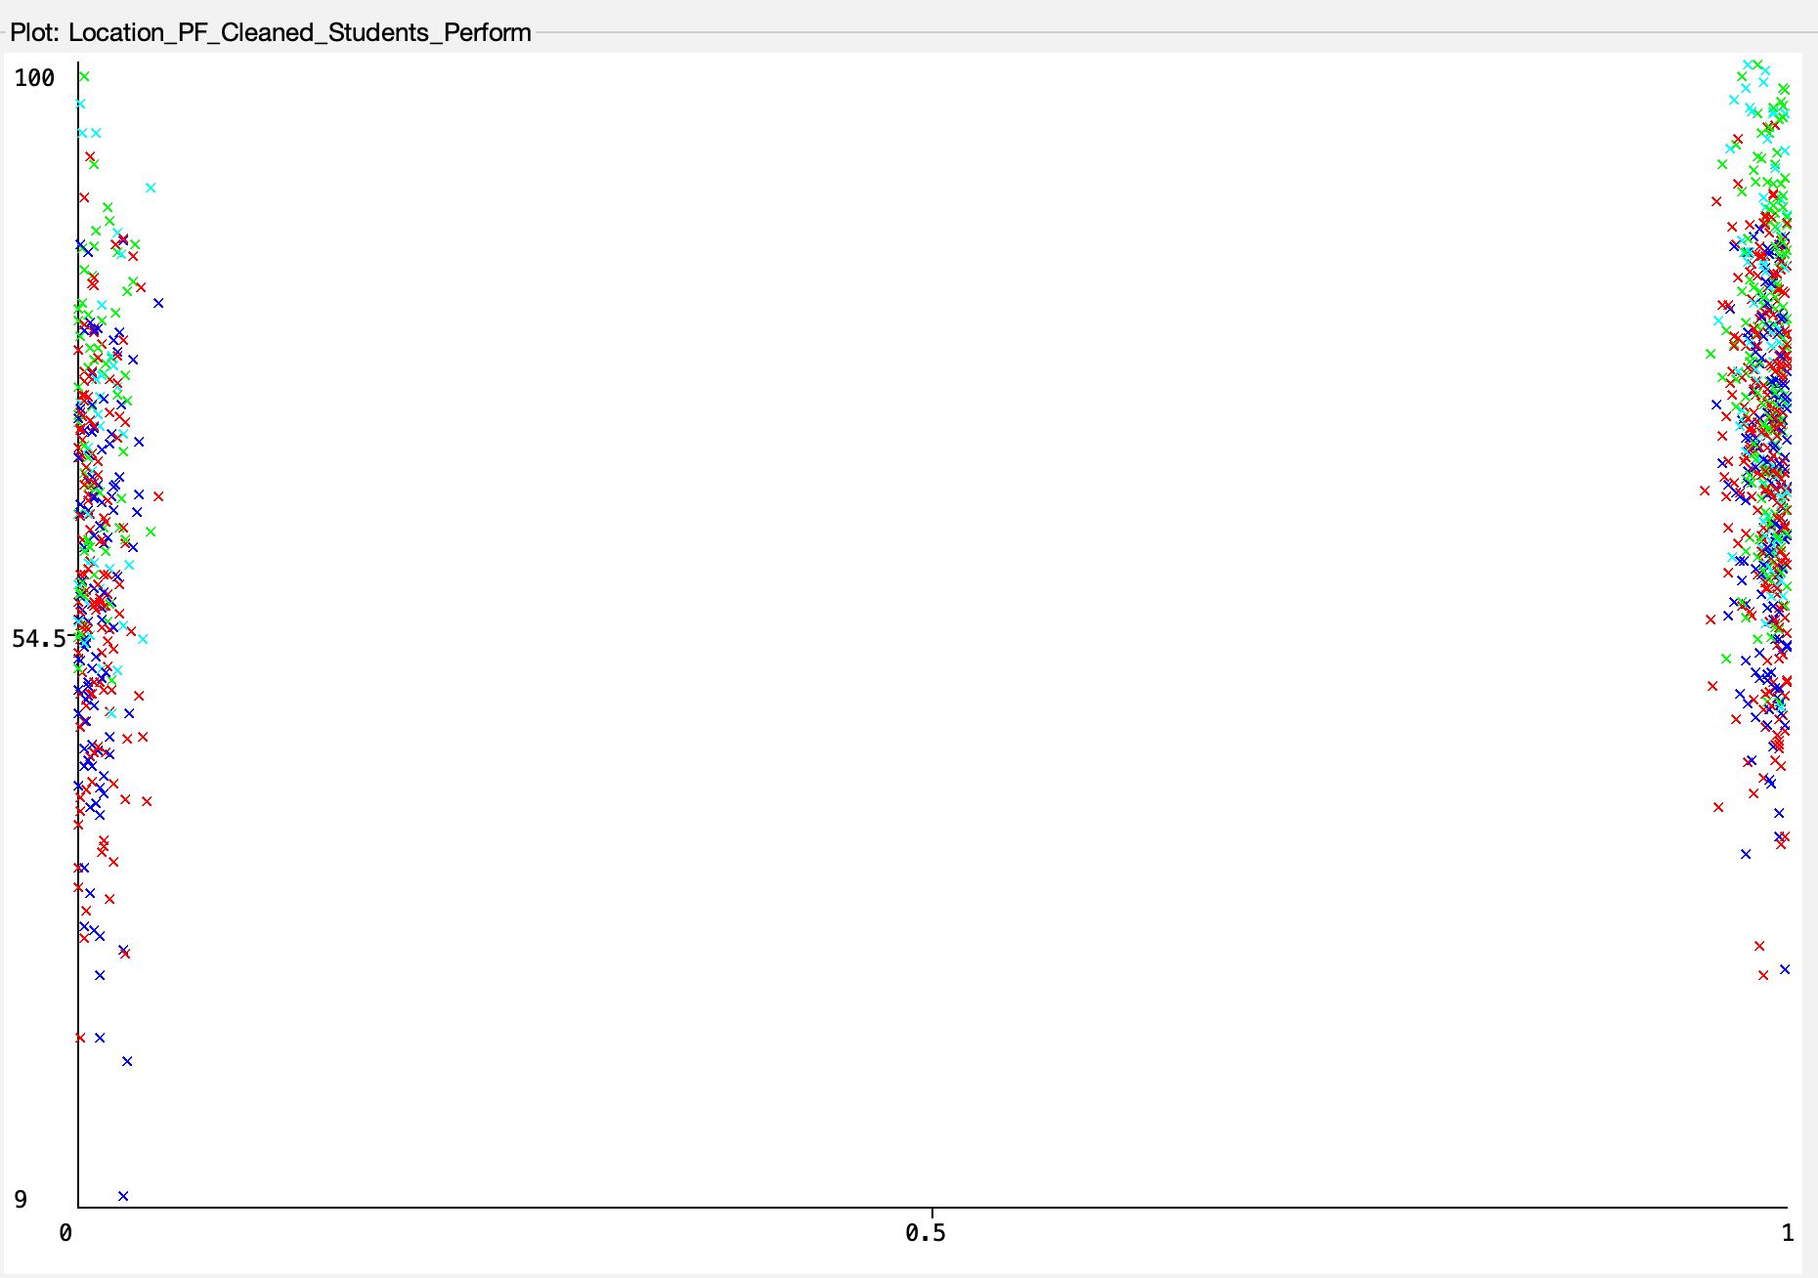
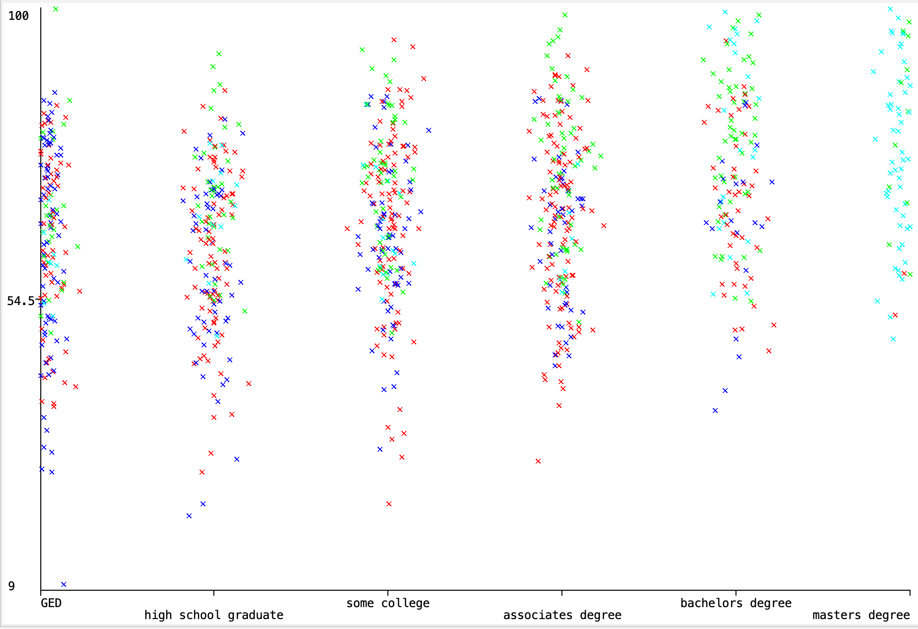
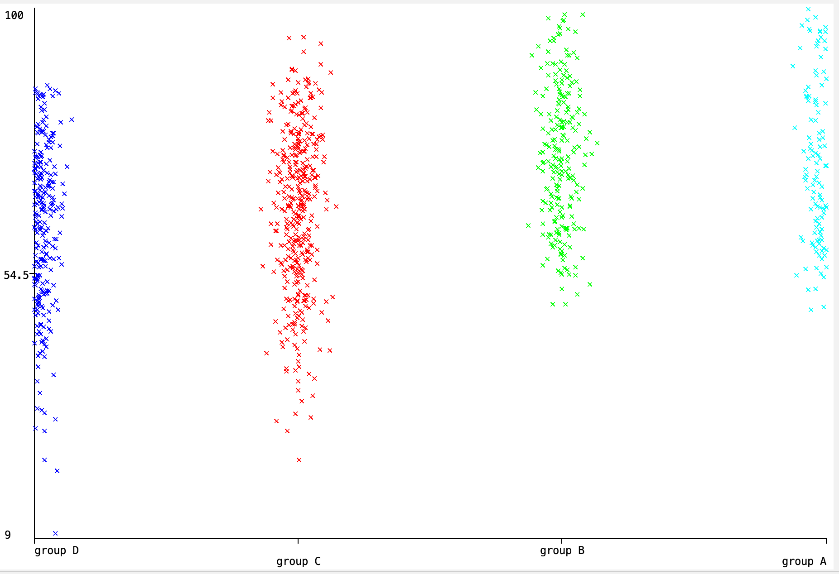
Visualization

Slide 23
Conclusion
Parents with higher education levels often foster a supportive and enriching home environment, promoting learning and intellectual growth in their children.
This advantage, combined with access to better resources such as quality schools, smaller class sizes, and experienced teachers, can significantly enhance academic performance.
Students from disadvantaged backgrounds can excel through their curiosity, perseverance, and motivation, highlighting the critical role of a supportive family and a child's personal drive in achieving academic excellence.

Slide 24
THANK YOU
QUESTIONS?

